Slide 1
Explore the Different kind of restaurants in Atlanta, GA
Published by
Manikandan Palanisamy

Slide 2
Introduction of Business Requirement
In this project, I am going to explore Atlanta and will try to find out what kind of restaurant is already popular in the target neighborhood.
This project can give insight to those people who want to open a restaurant in Atlanta, GA. Assuming they have not decided what kind of restaurant they are going to open, I can show them which kind is already popular and better not to open the same.
Before that I need to know about features of each neighborhoods and decide which kind of restaurant is suitable for that particular regions. Based on features of selected neighborhoods, we are going to search the most popular kind of restaurant in these areas.

Slide 3
Data Requirement and Data Collection
Based on definition of our problem, points that will influence our decision are:
The features of each neighborhood
what kind of restaurant has already opened in the selected neighborhood?
Following data sources will be used:
neighborhood list of Atlanta City of Atlanta(via Kaggle.com)
venues in each neighborhood will be obtained using Foursquare API (via www.foursquare.com)

Slide 4
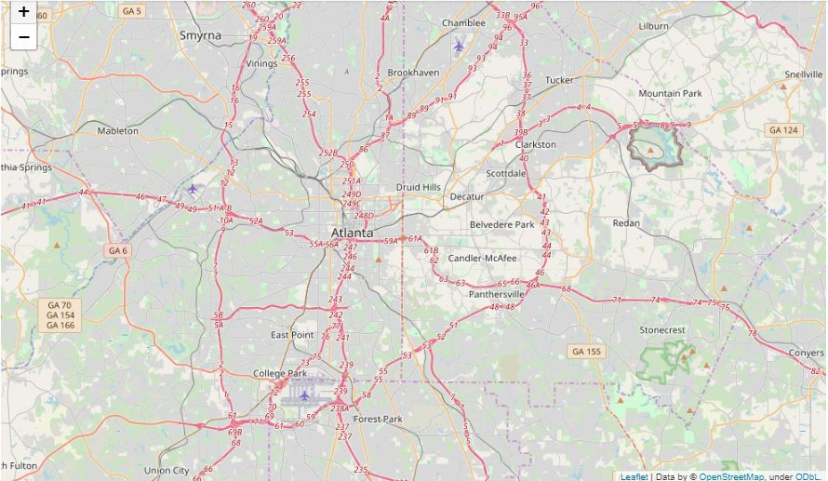
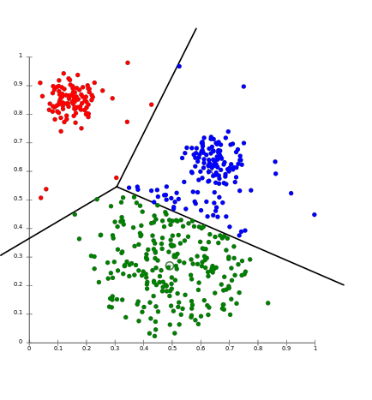
Data Cleaning and Modeling
In this project, I detect venues in an area ~2km around each neighborhood center.
Data Cleaning:
I have collected and cleaned the required data:
neighborhood list in Atlanta
Venue around each neighborhood
Modeling:
I am going to explore these neighborhoods by the categories of venues. I will use K-means to cluster neighborhoods and find which cluster is suitable to open a restaurant.

Slide 5
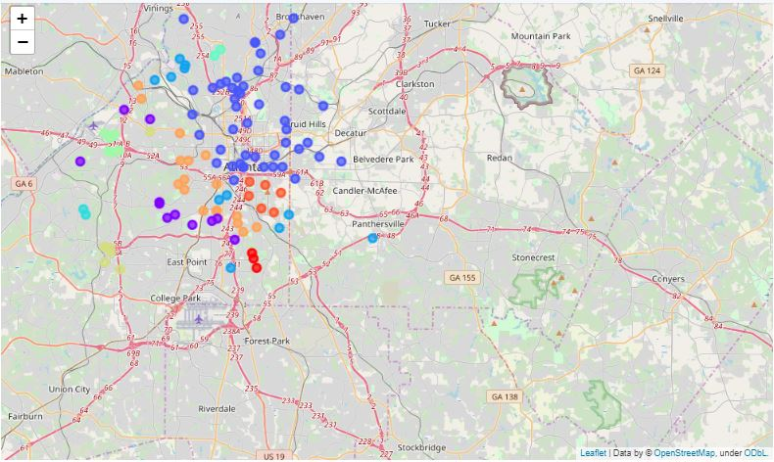
Model Evaluation and Analysis
I will evaluated more in this selected cluster.
Each neighborhood in this cluster will be analyzed and discussed, and we want to know opening which kind of restaurant in a specific neighborhood could be profitable.
We will present a map to tell our results shown.

Slide 6
Feedback and Result
Based on the clustering of neighborhoods, I found that areas in Cluster (K=2) are good places to open a restaurant.
Since the distribution of Cluster(K= 2) is around the center of Atlanta, then I want to open a restaurant near Gatech, Midtown and Atlantic
The neighborhoods listed below satisfy my criteria:
Ansley Park
Atlantic Station
Brook-wood
Georgia Tech
Loring Heights
Midtown

